Slide 1

The Security Guide to the Internet
Let’s play and learn

Slide 2
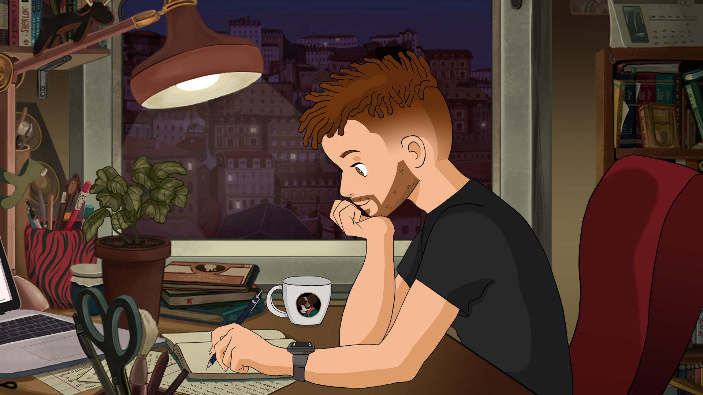
Who am I
Magister student at MFF with focus on game development and visual computations.

Slide 3
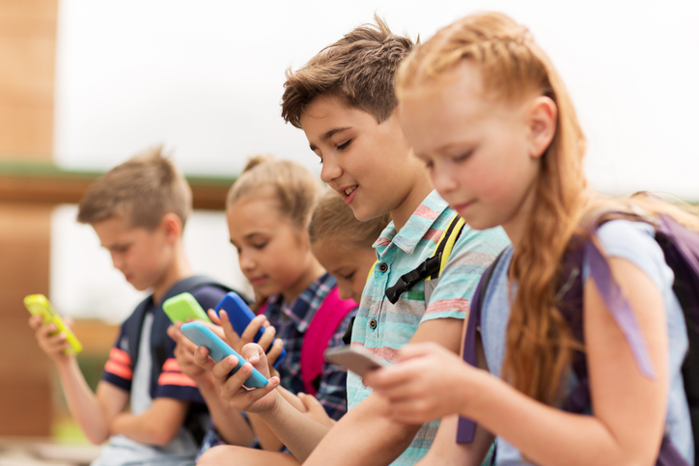
Target Audience
Middle school students.
Single player at home, or at school.
Czech or English speaking.
Years 12-15
Kids doesn’t have much security awareness and they are often exposed to cyber danger
Image from freedomfone.org

Slide 4

Security thread topics
Malware: Virus, Antivirus, Firewall, Software updates, Data backup
Fake file extensions, Harmful pdf, Game with virus, Fake free stuff
Antivirus is a good thing, but it doesn't do everything
Privacy: Stealing credentials, Phishing, Identity theft, Social engineering
Digital footprint, Privacy protection, Cookies
Bad practices, Malicious wi-fi, Leaving the device unlocked
Phone: Permission to take photos, contacts, etc.
Children think that there is no antivirus for mobile phone
Access: Weak passwords, Cookies, Two-factor Authentication

Slide 5

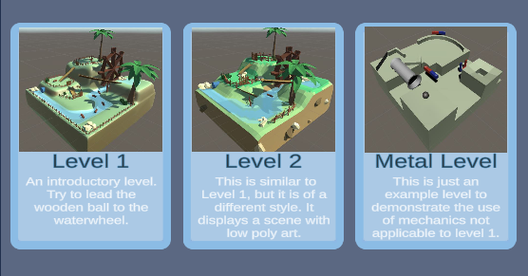

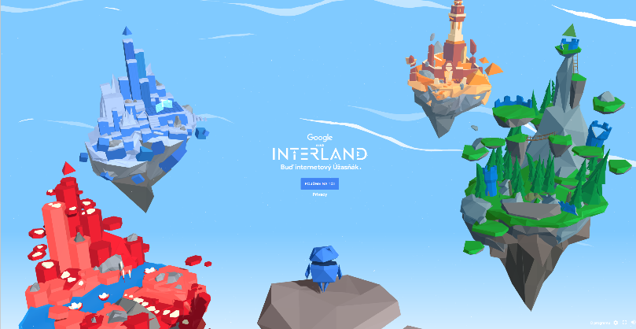
Multiple levels
Each for some group of security topic
Each with unique gameplay mechanic
Multiple devices support
iPhone, Android, Computer
Low poly design
Inspiration from Google’s INTERLAND
Game On
Image sources: https://img.itch.zone/aW1nLzI1OTQ4OTQucG5n/original/863Q0t.png
https://beinternetawesome.withgoogle.com/en_us/interland

Slide 6
Gameplay
GENRE | MECHANIC | EXAMPLE
Hyper casual game | Easy to understand | Subway surfers
RPG | Role playing Better immersion into the situations | Witcher
Action - adventure | Active gameplay mixed with story telling | The legend of Zelda
Puzzle | Thinking about right solution | Papers please

Slide 7




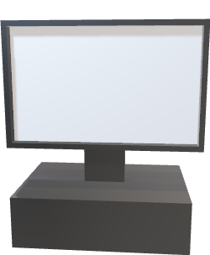

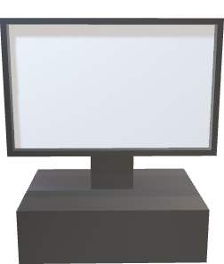
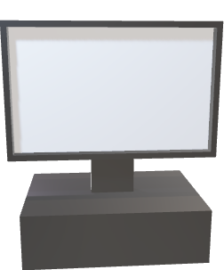

Minigame Sketch
Quarantine
File is OK
Emulator
Emulator
Emulator

Slide 8
Timeline
2/2024
1. Semester
7/2024
2. Semester
2/2025
3. Semester
7/2025
Research and planning
Game development
🌴 Vacation
Adding more levels
User testing
Game polishing
Writing thesis
Finishing
Visuals and mechanics

Slide 9

Thank You
All non-CC sources are listed here: https://github.com/EbrithilNogare/TheSecurityGuideToTheInternet/wiki/Sources

